Slide 1



Xavor
Gen-AI Bootcamp
Presented by:
Kabir Ahmad
2024-GENAI-34

Slide 2




Agenda
1
3
Techniques of Gen-AI
Task Done Till Now
2
4
Talks - Sessions
Project - Discussion

Slide 3


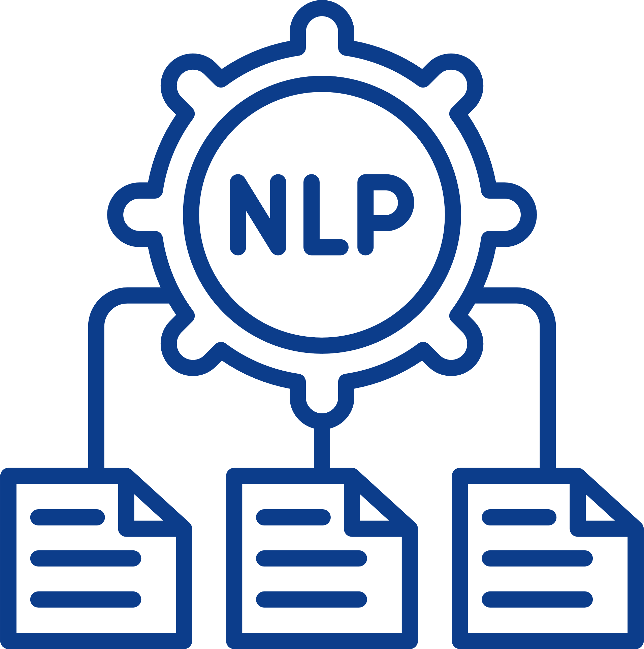

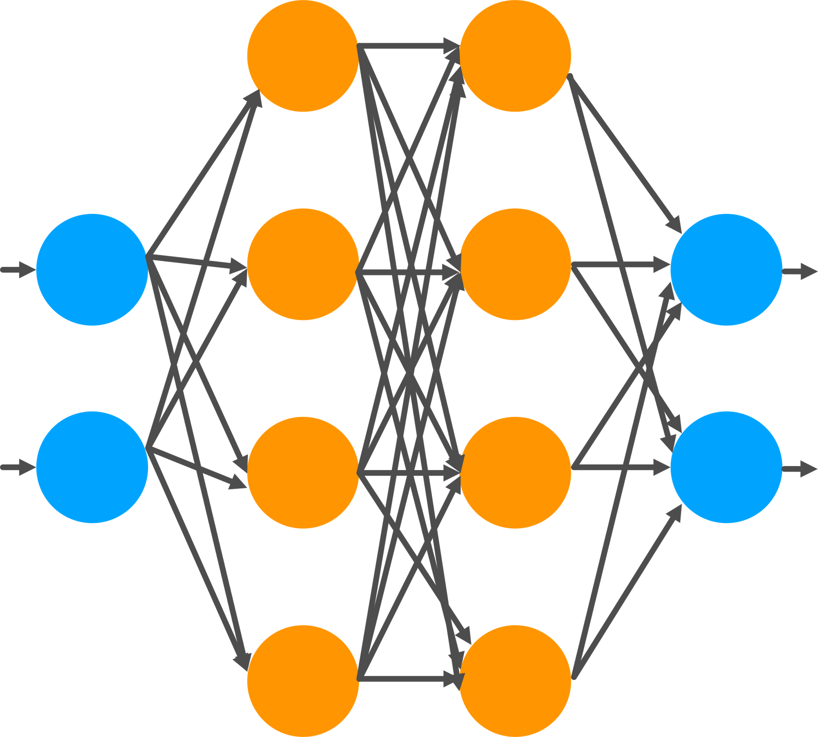

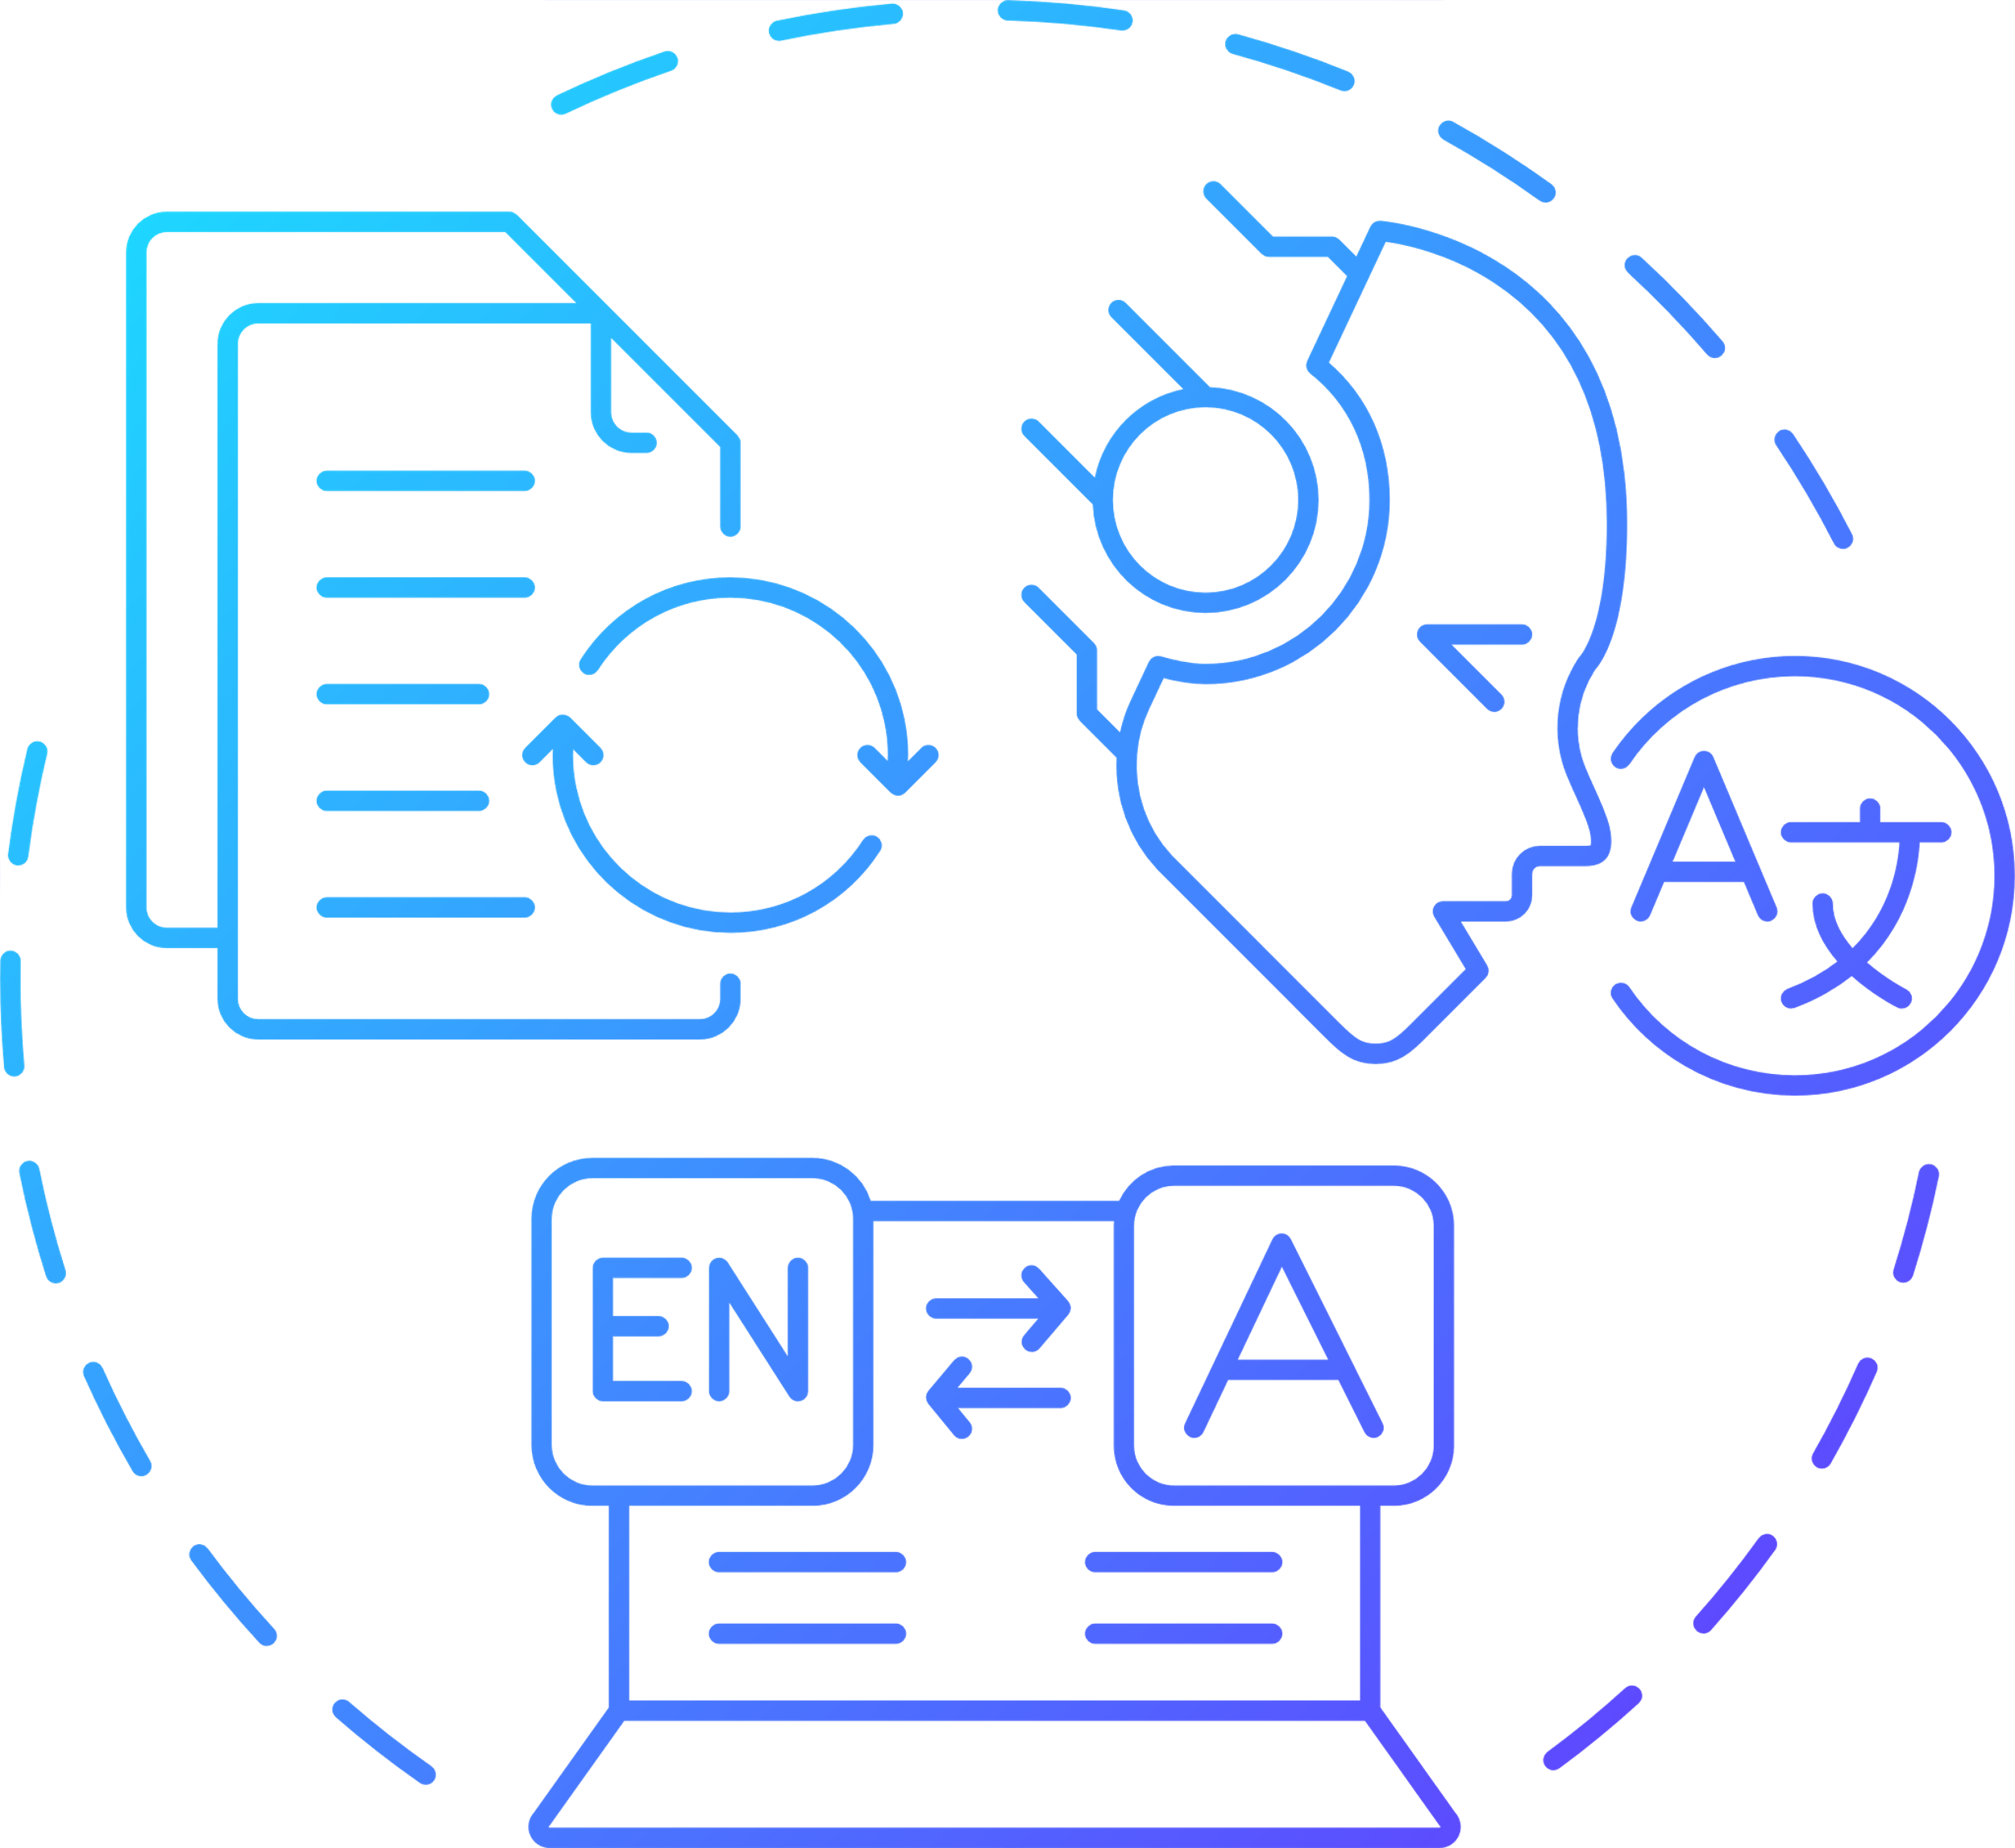
Techniques of Gen-AI
Some major techniques that teach so far in this Bootcamp are:
NLP- Techniques
Prompt Engineering
Neural Networks
Retrieval-Augmented Generation (RAG)
LangChain / LLama
Difference
Text Pre-Processing, Word-Embeddings, Lemmatization
, Stemming, Bag of words
Tf-IDF
Prompt Structure, Clarity and Specificity, Types of Prompts ,
Iterative Refinement
Long Short-Term Memory (LSTM), Gated Recurrent Unit (GRU), Recurrent Neural Network (RNN)
Run and Train the RAG model on Different Document
Difference Between Llama and Langchain Results

Slide 4







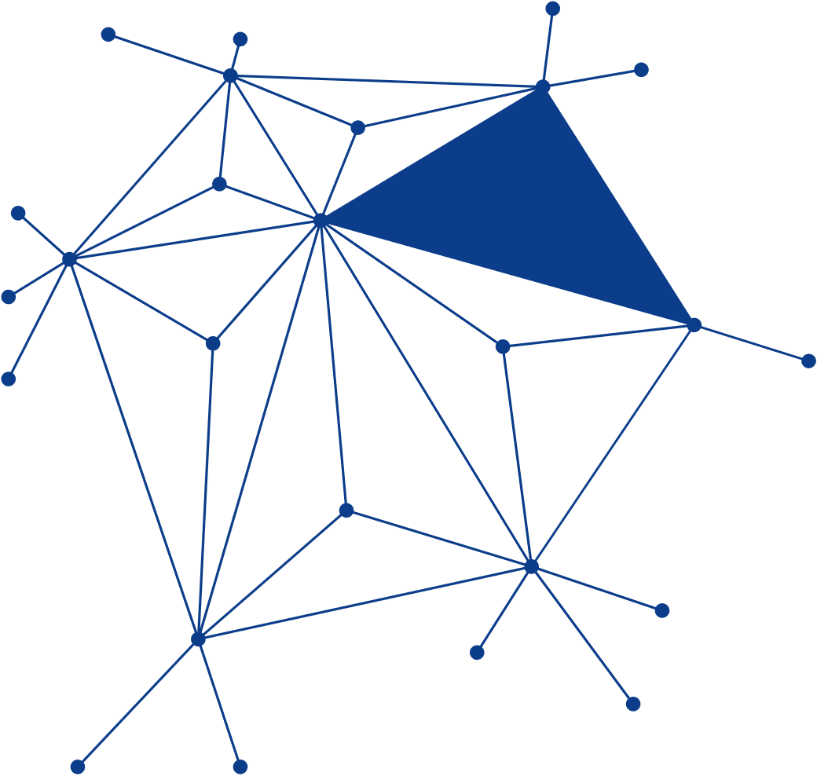

Tasks of Gen-AI
Presentation on IDF and TF
Use of Generative AI in Medical Fields
Report on openCHA
Langchain Prompt Template
LLM Chains
Comparison of Advance Preprocessing Techniques
Comparison of few shot, zero-shot ,
cot
Generative-Adversarial-Networks-GAN
Weather Chatbot

Slide 5
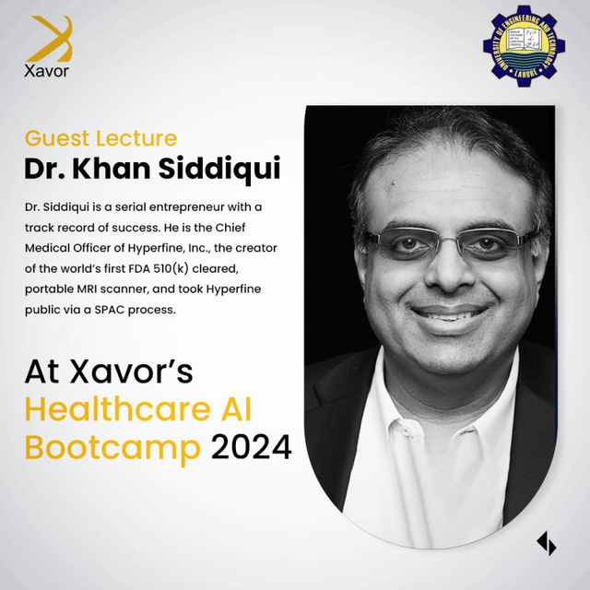
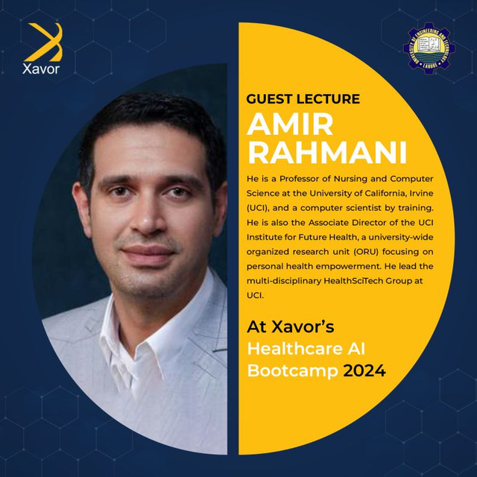
Talks & Sessions
Major Talks and Session I joined during this Bootcamp
Talk on Basic Overview / Agenda of this Bootcamp
Talk on openCHA and its artitechure

Slide 6
Project
Analysis of TB Xrays
Image Classification of Xrays using Deep Learning Networks
Fine Tune the Model on the Custom Dataset of TB
ChatBot

Slide 7


Project - Progress
Data Set Collection
Classification of Lungs -Xray
Textual Data- Pre Processing
Fine Tune the llama Model

Slide 8
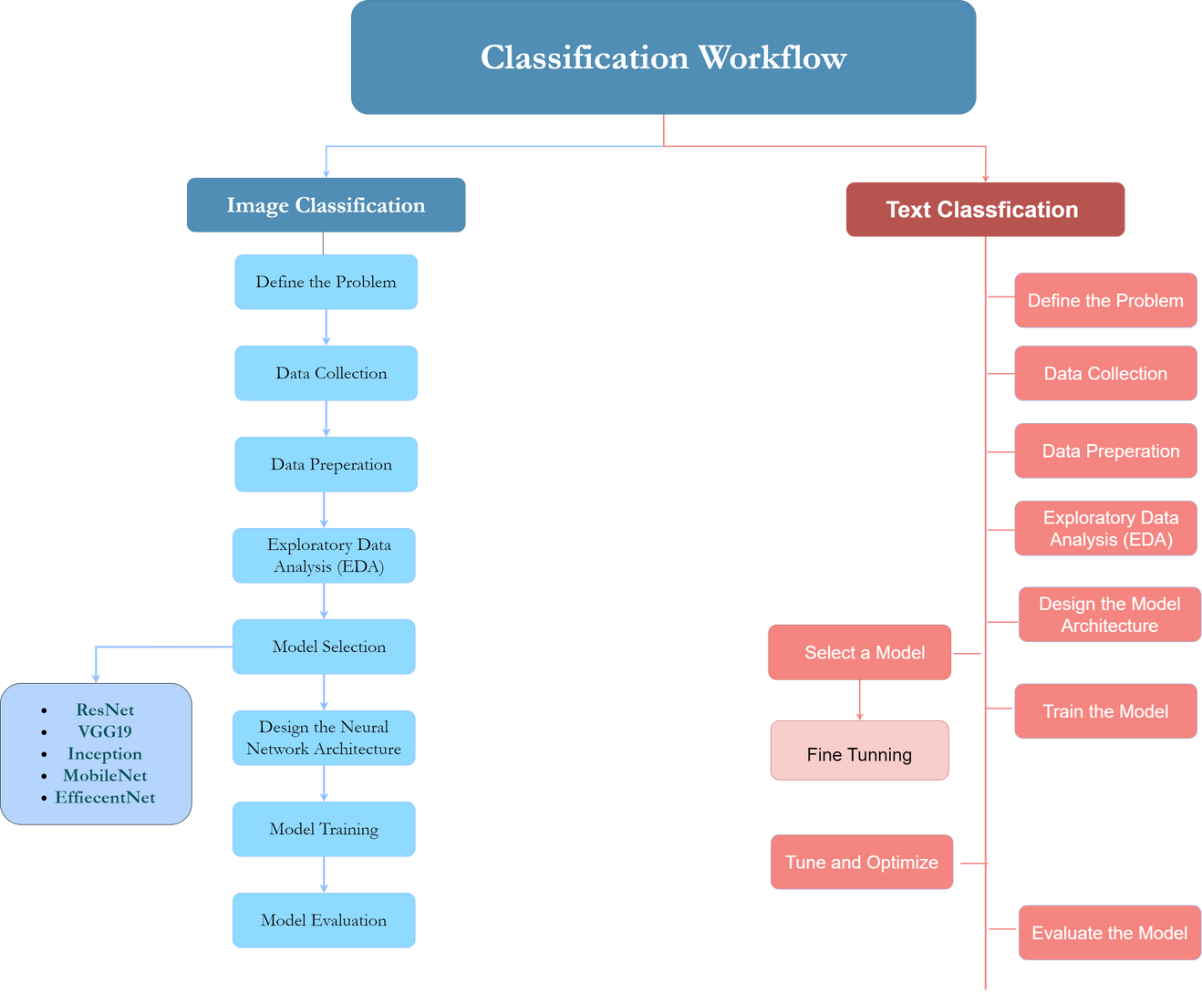
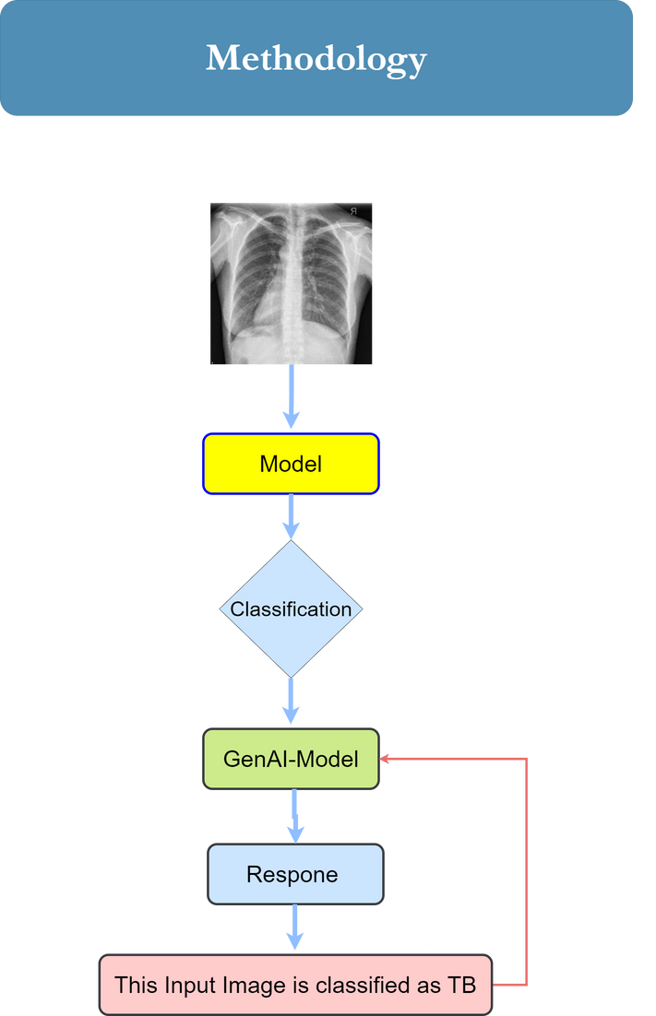
Project - Methodology

Slide 9

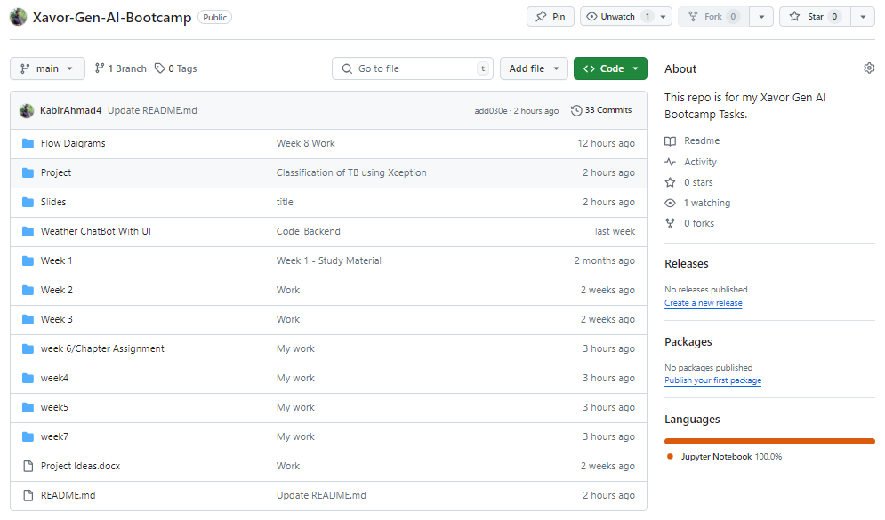
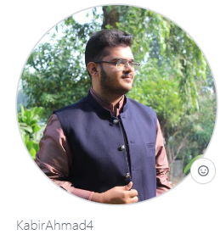
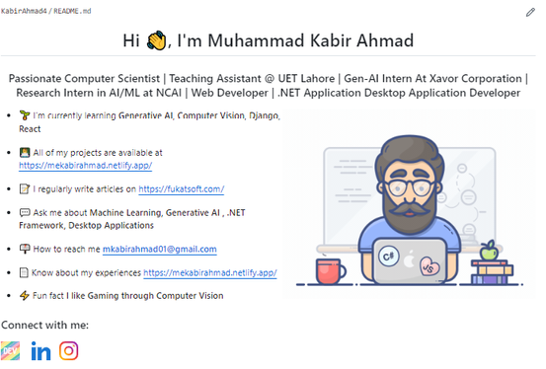
Github

Slide 10
Thank You

